Slide 1
optimal storage on tapes using greedy approach
Design And Analysis of Algorithms
By
Katla Yashwanth (2010030364)
K.Venkatesh (2010030359)
K.Pavan Vikhyath (2010030087)
Karthik (2010030520)
Under the guidance of
Udaya Rani mam

Slide 2
Problem statement and domain
Tape is characterized by sequential access to data. While tape can provide fast data transfer, it takes tens of seconds to load a cassette and position the tape head to selected data . For example, Suppose there are 3 programs of lengths 5, 10 and 3 respectively. So there are total 3! = 6 possible orders of storage. Retrieval time of the data is the time taken to retrieve/access that data in its entirety. Hence retrieval time of the third program is 5+10+3 = 18 mins. So here as we can see, to retrieving a program is a time taking process.

Slide 3
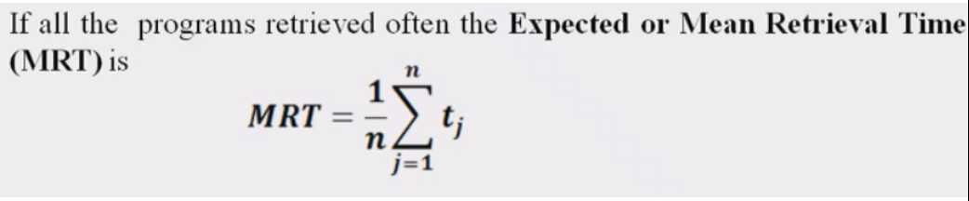
Existing solutions/ Naïve solutions
Now, considering that all programs in a magnetic tape are retrieved equally often and the tape head points to the front of the tape every time, a new term can be defined called the Mean Retrieval Time (MRT).

Slide 4
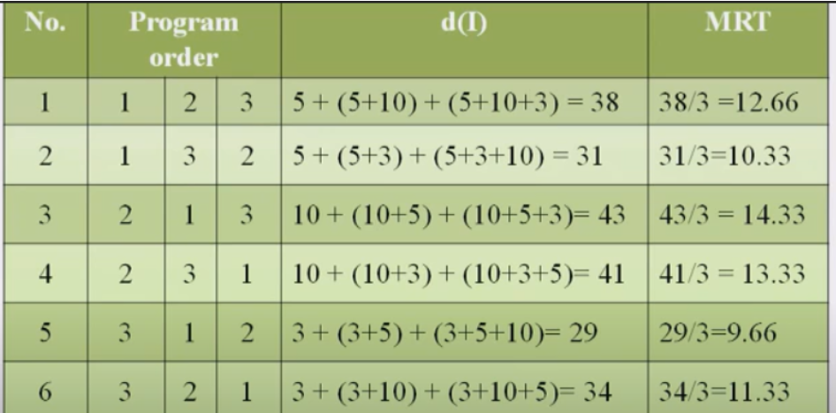
Now from the above example
Let n=3, (l1, l2, l3) = (5, 10, 3)
From the graph beside, we can see the min(MRT) = 9.66. So, the best possible order of programs is (Program3,Program1,Program2)
That’s the Greedy Algorithm in use

Slide 5
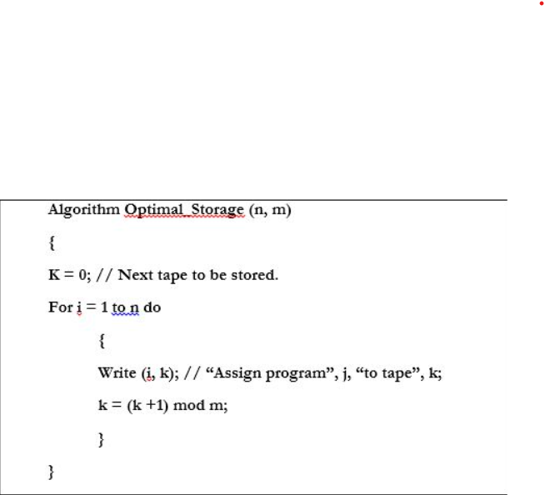
Proposed Algorithm Design Technique
For the solution of this problem we have used the greedy algorithm. at each step we make the immediate choice of putting the program having the least time first, in order to build up the ultimate optimized solution to the problem piece by piece. The algorithm used is shown in the image. This ordering can be carried out in O(n log n) time using an efficient sorting algorithm.

Slide 6
Data Structures needed
Sorting : -
Quick Sort , The time complexity of Quicksort is O(n log n) in the best case, O(n log n) in the average case, and O(n^2) in the worst case. But because it has the best performance in the average case for most inputs, Quicksort is generally considered the “fastest” sorting algorithm.

Slide 7
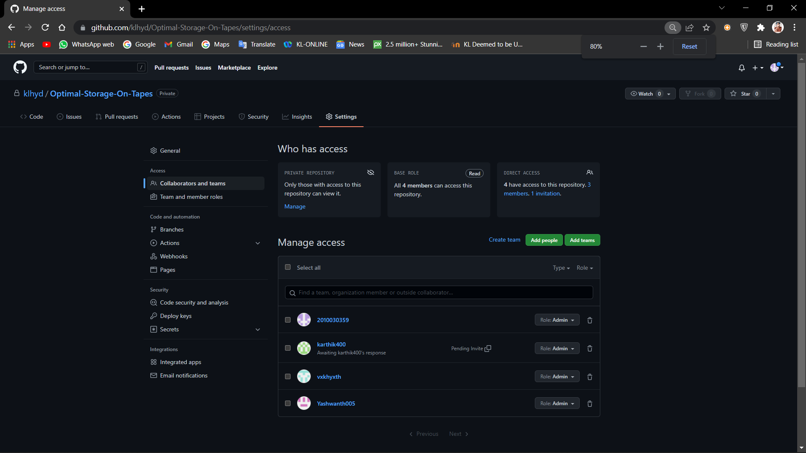
Github setuP
https://github.com/klhyd/Optimal-Storage-On-Tapes/settings

Slide 8
Division of work among the group members
Coding and Testing – Yashwanth,Venkatesh, Vikyath,Karthik
Algorithm And Flowchart – Yashwanth,Venkatesh
Analyse Data And Techniques – Vikyath,Karthik

Slide 9


